Slide 1


Slide 2


Slide 3


Slide 4
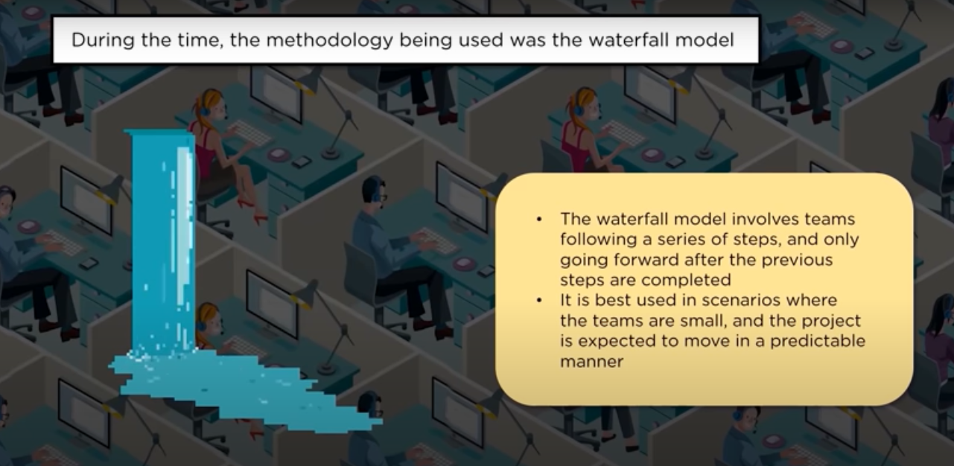

Slide 5
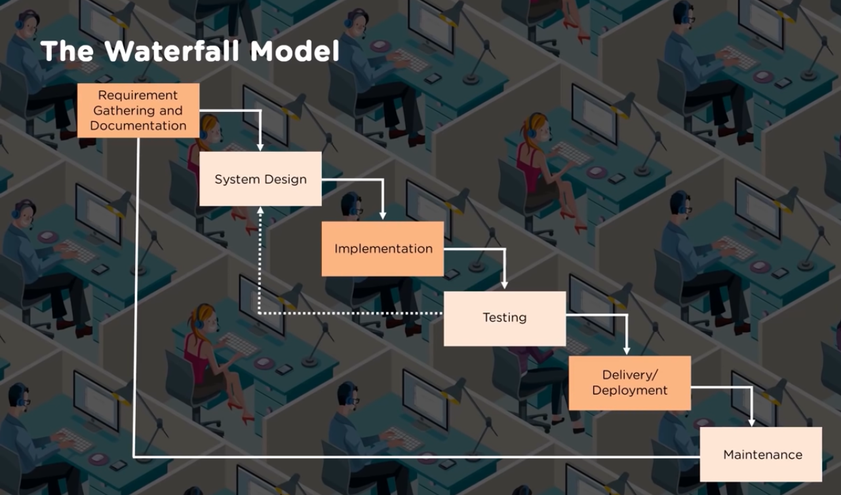

Slide 6
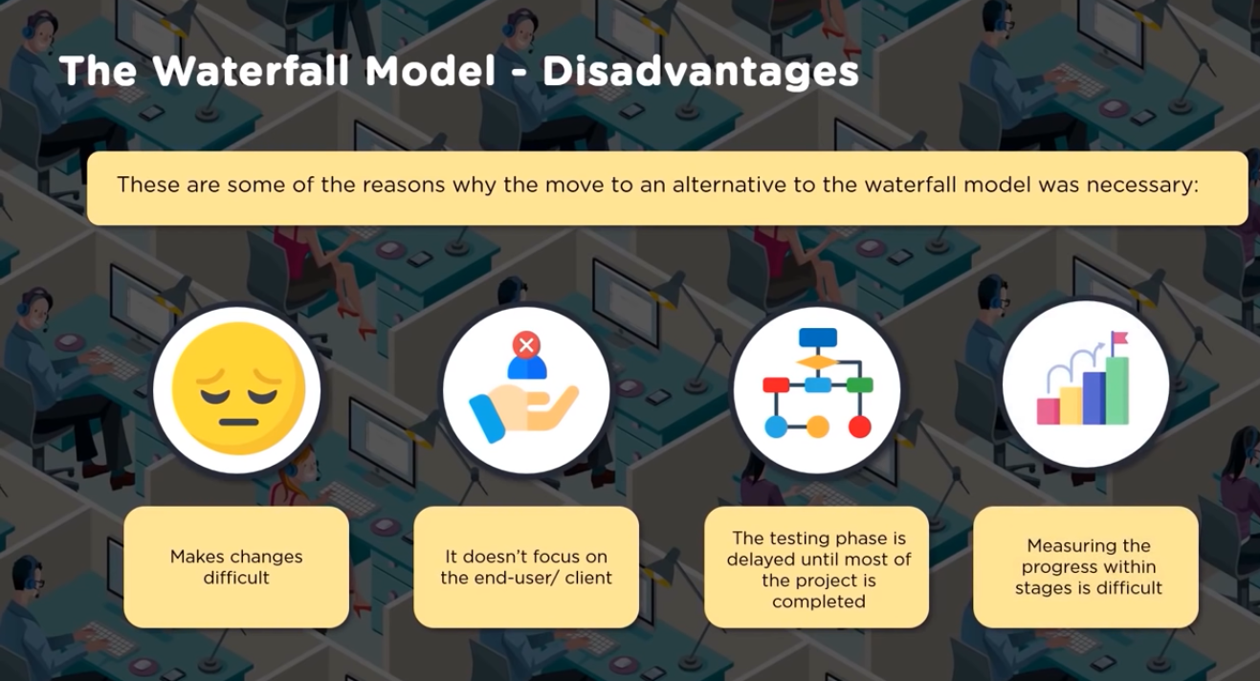

Slide 7


Slide 8


Slide 9
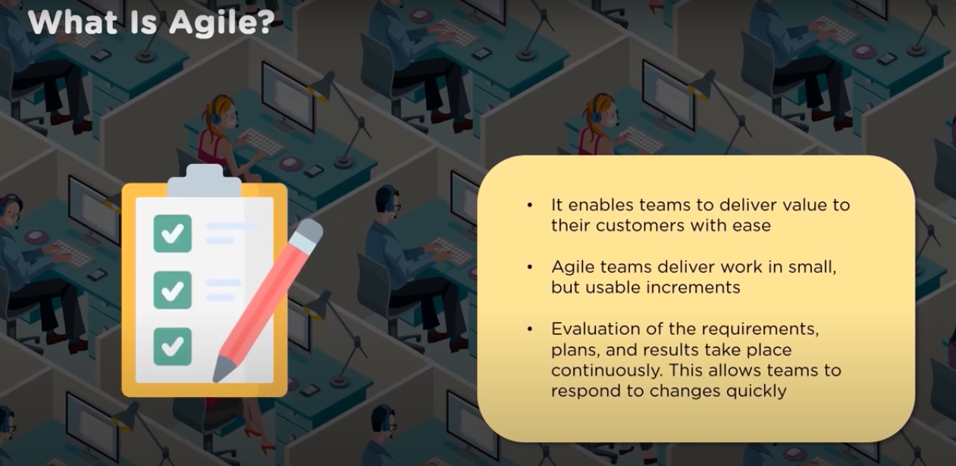

Slide 10

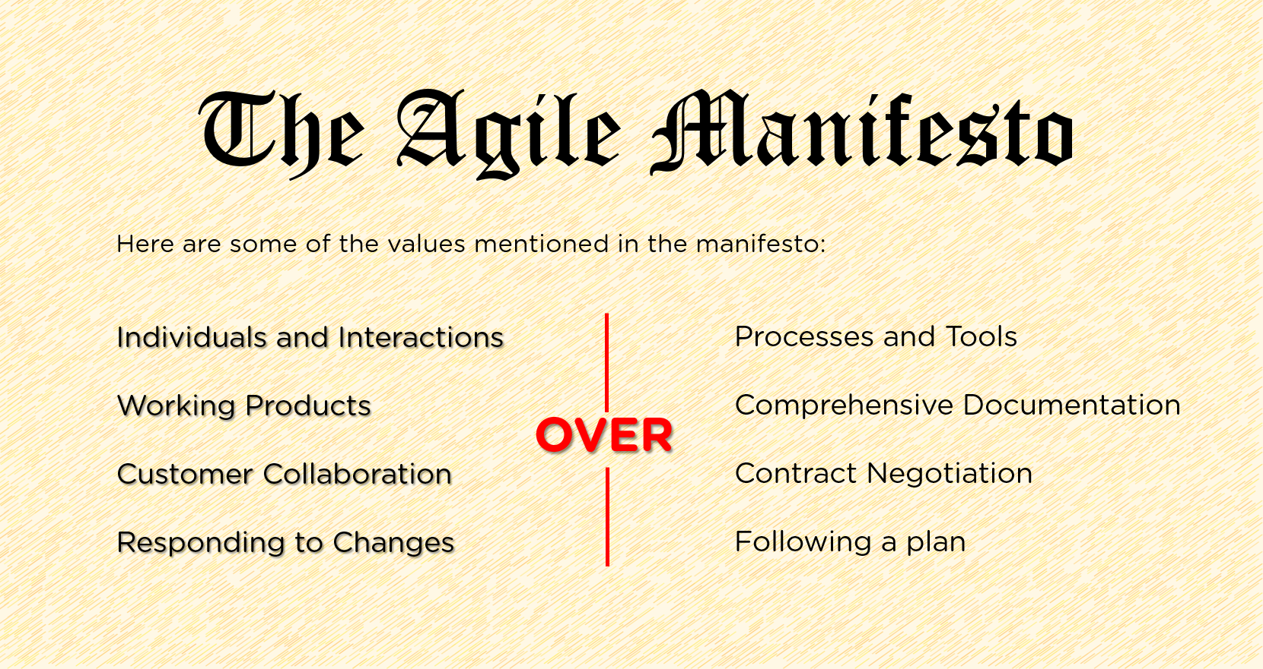
What is agile ?

Slide 11


Slide 12
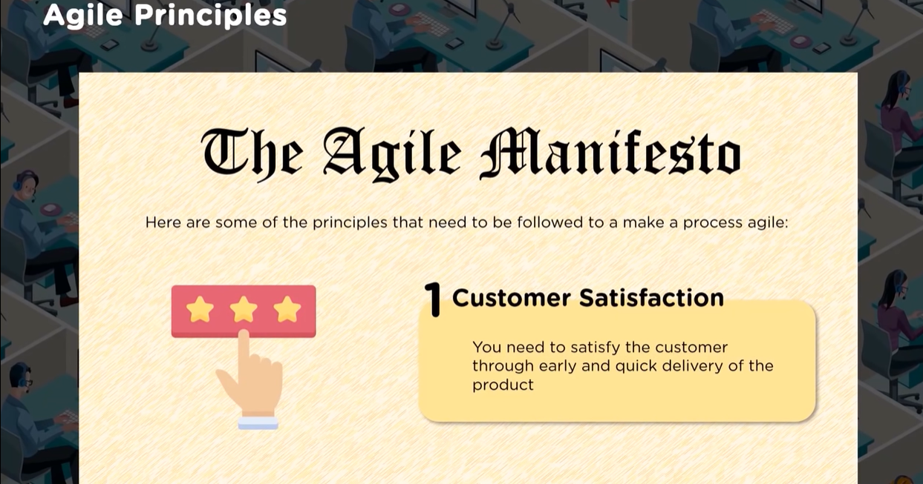

Slide 13
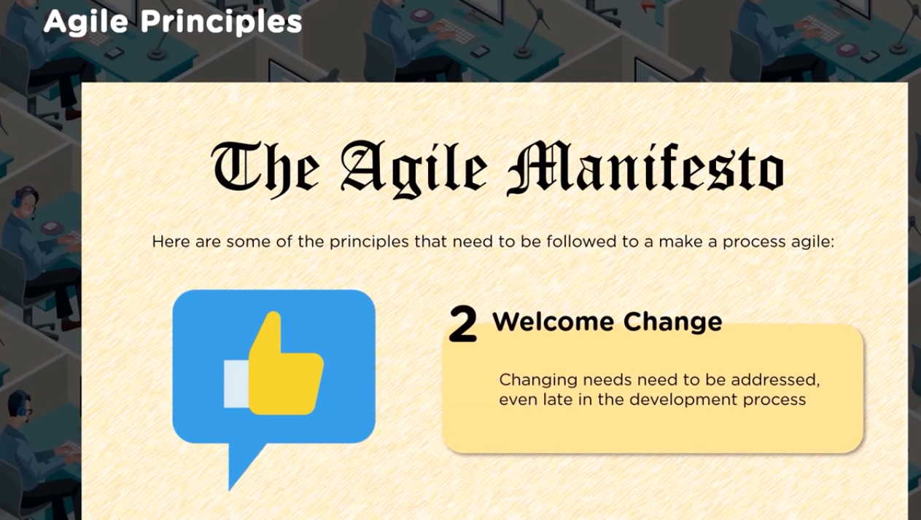

Slide 14
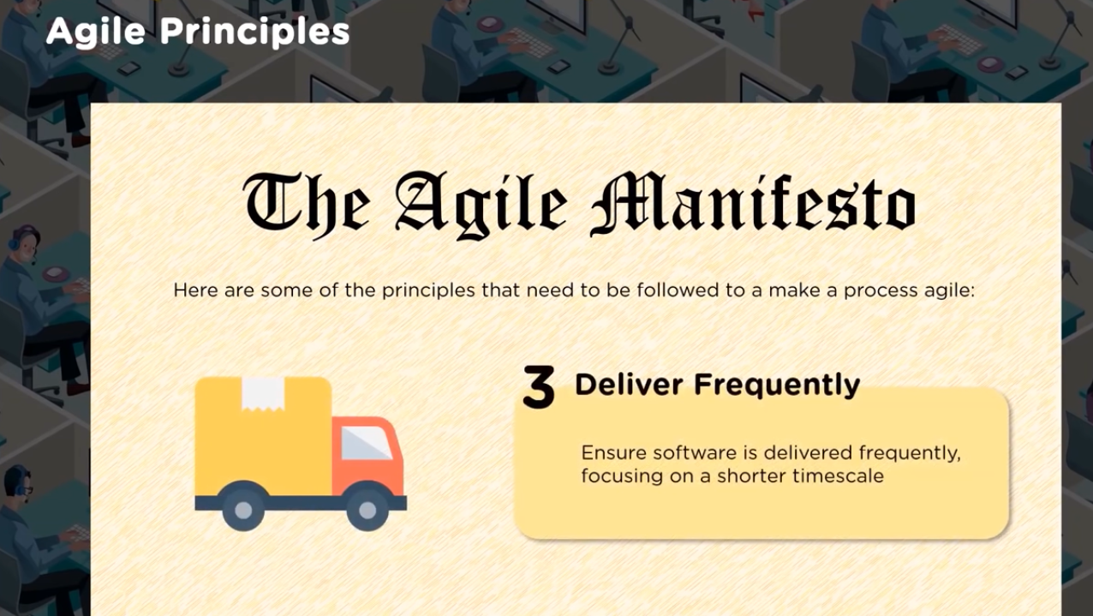

Slide 15
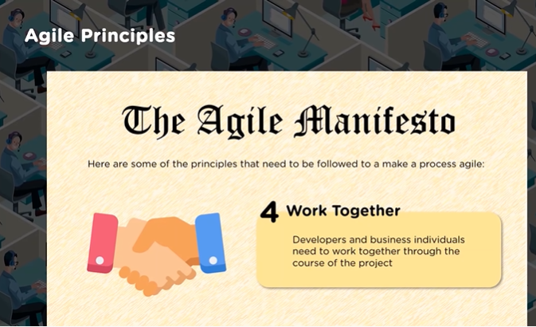

Slide 16
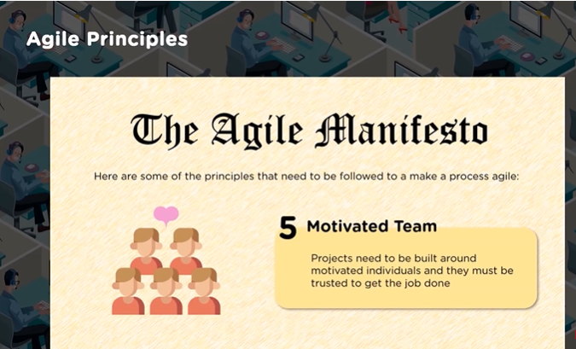

Slide 17


Slide 18
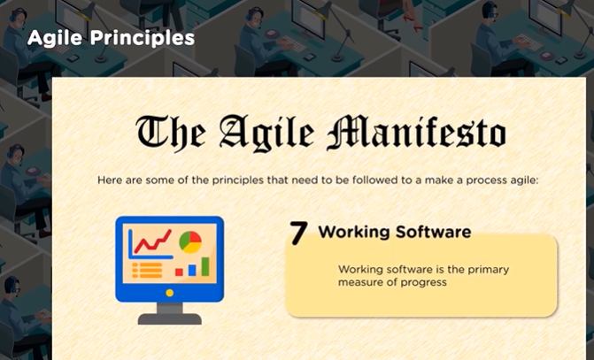

Slide 19
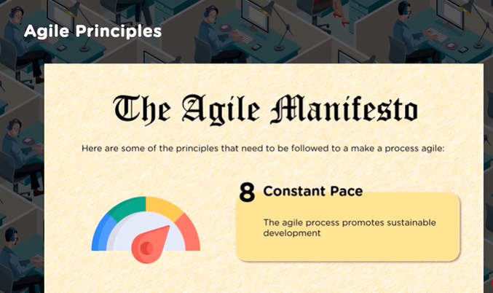

Slide 20
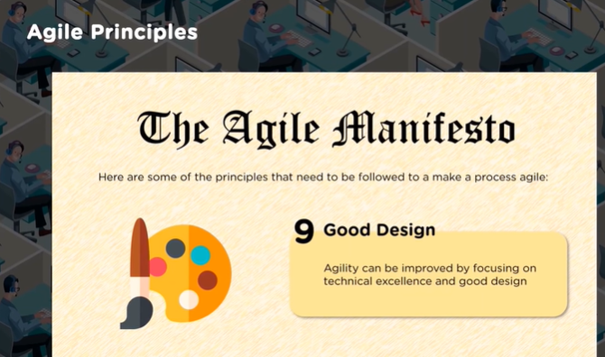

Slide 21
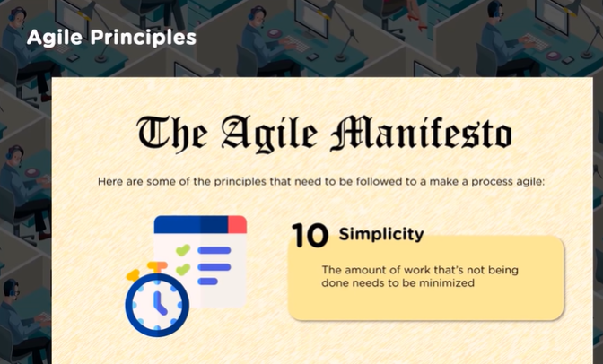

Slide 22
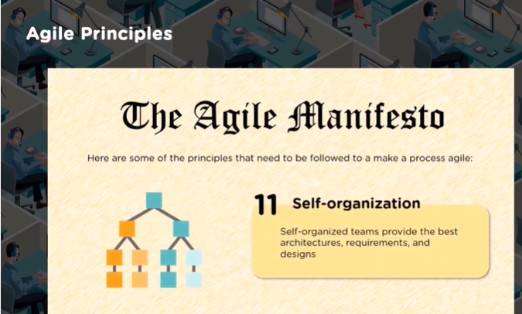

Slide 23
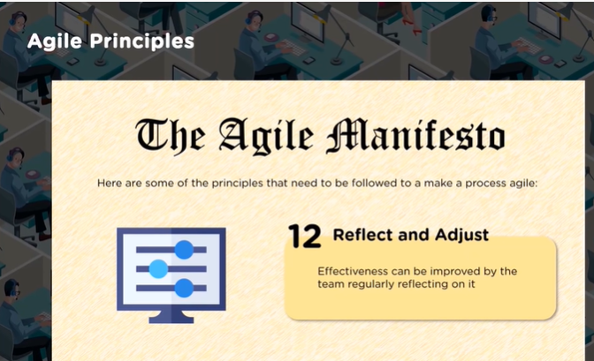

Slide 24


Slide 25
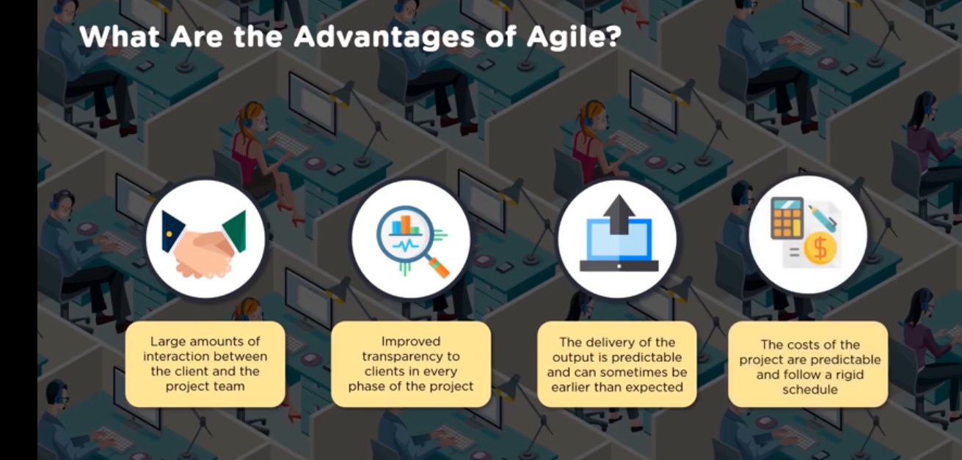

Slide 26


Slide 27
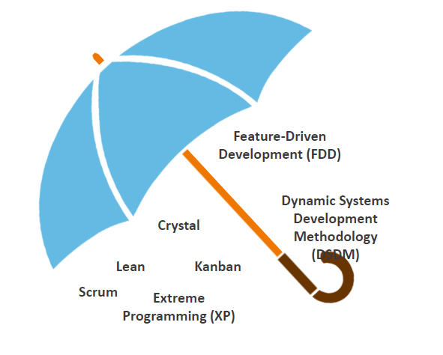
Agile Methods :

Slide 28
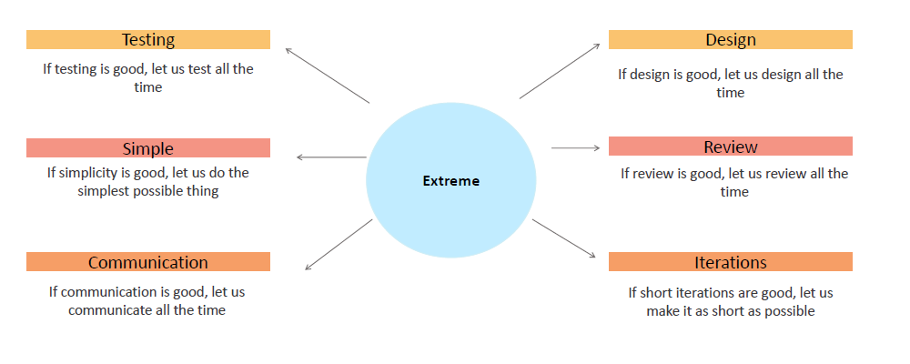
Extreme Programming (XP)
Extreme Programming is a system of practices to develop high-quality software.

Slide 29
Crystal Method
Crystal is a family of methodologies invented by Alastair Cockburn. Following are the seven properties of Crystal Project:
Frequent Delivery
Reflective Improvement
Personal Safety
Close or Osmotic Communication
Focus
Easy Access to Expert Users
Technical Environment

Slide 30
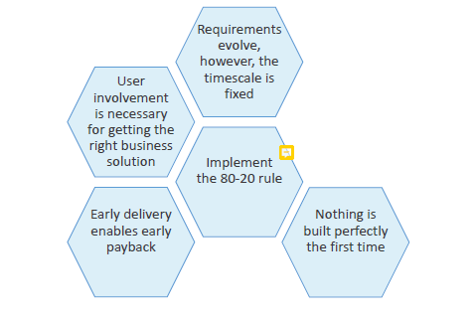
Dynamic Systems Development Method (DSDM)
Dynamic Systems Development Method (DSDM) is a comprehensive methodology which was first published in 1994. A revised version of DSDM, also known as Atern, was published in 2007. This technique is popular in UK. Following are the basic concepts of Atern:

Slide 31
Lean
Lean originated from the Toyota Production System in 1950.
This technique focuses on the elimination of waste by creating the value stream map for the process.

Slide 32


Slide 33
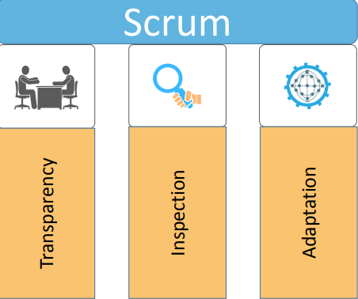
What is scrum:
Scrum is one of the most popular Agile frameworks. The three pillars of Scrum are as follows:

Slide 34
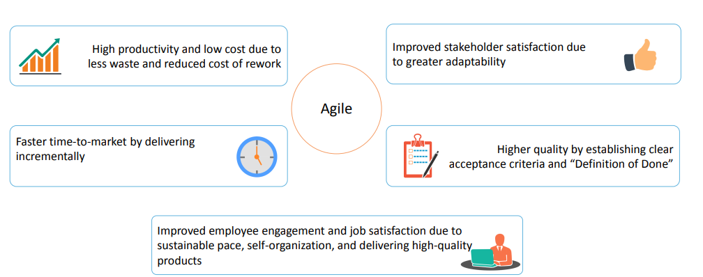
What is a scrum:
Benefits of scrum/agile:

Slide 35
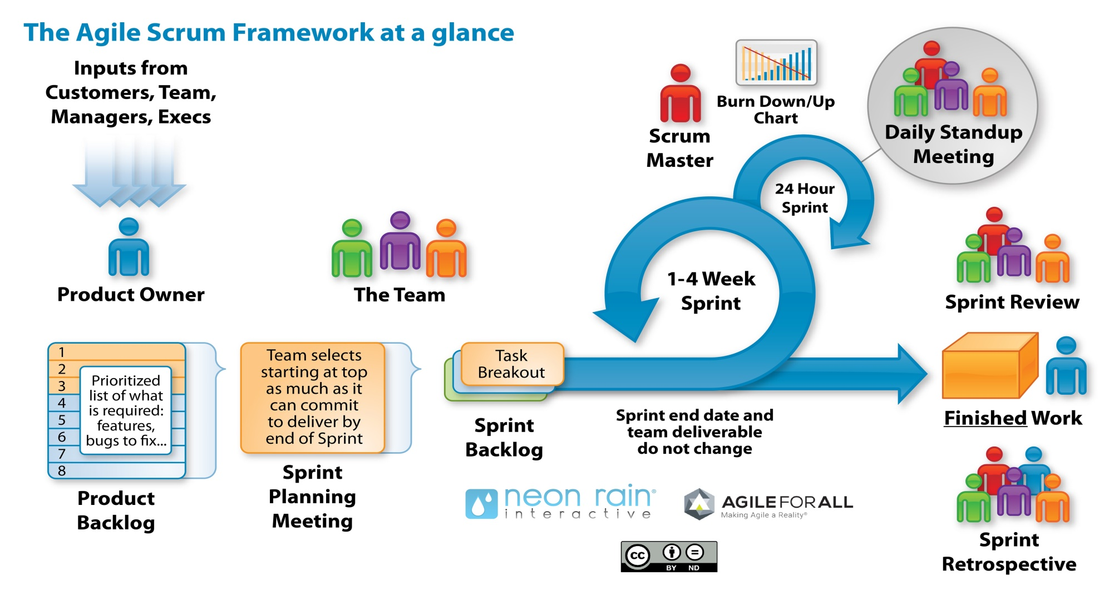
Scrum life cycle :

Slide 36


Slide 37
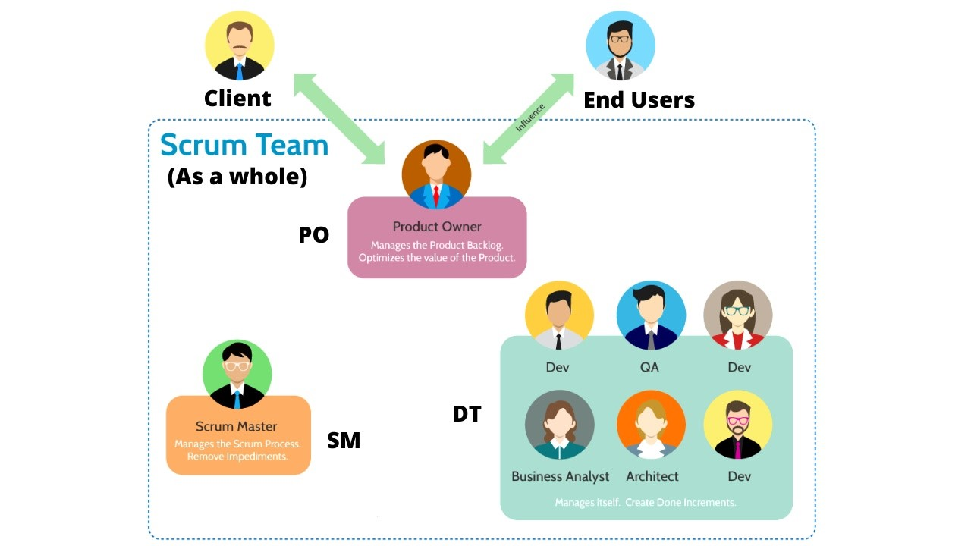
Scrum Role ,Events and Artifacts
Scrum Team and Roles:

Slide 38
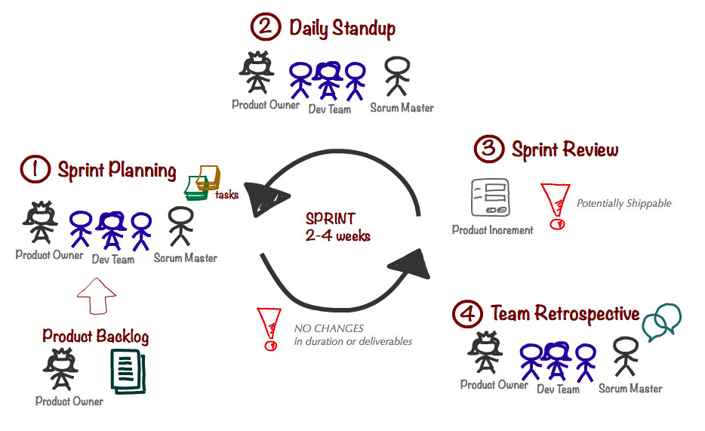
Scrum Role ,Events and Artifacts
Scrum events:

Slide 39

Agile Estimating, Planning, Monitoring, and Control

Slide 40
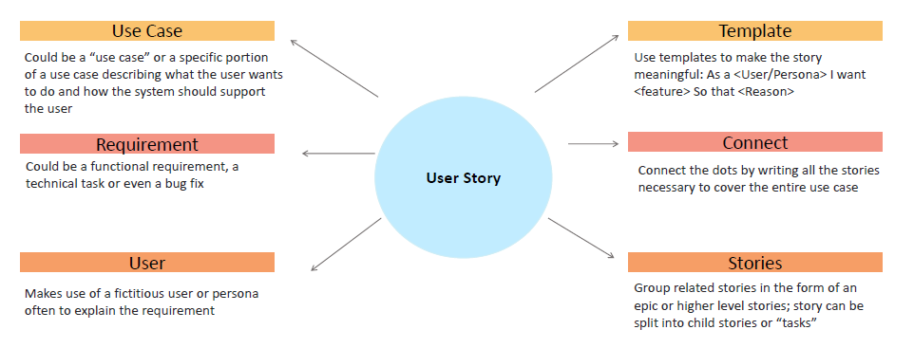
Agile Estimating, Planning, Monitoring, and Control
User Stories, Epics
User Stories and Epics describe anything of value that the team can produce for the customer.

Slide 41
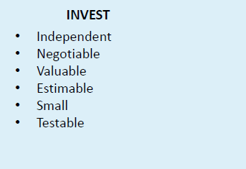
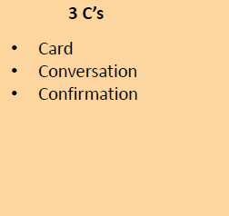
Agile Estimating, Planning, Monitoring, and Control
Characteristics of good user stories:

Slide 42
Agile Estimating, Planning, Monitoring, and Control
Velocity
Velocity of the Team helps understand the productivity of the Team.
Definition
Velocity is the amount of work that can be completed in a Sprint. It is the sum total of the size of completed stories in a given Sprint.
Uses
Velocity is useful to answer questions such as:
•How many stories should we accept in a given Sprint?
•How many Sprints do we need to complete a set of stories?
Example
A team completed 5 stories of sizes 5, 3, 8, 13, and 2. Two stories of size 5 are half complete. What is the velocity of the team?
Ans. Velocity = 5 + 3 + 8 + 13 + 2 = 31

Slide 43
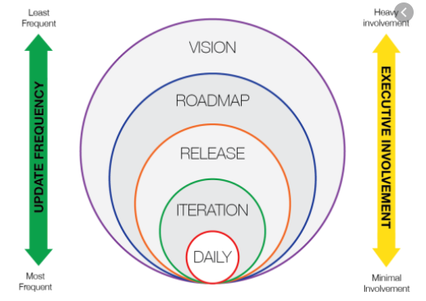
Agile Estimating, Planning, Monitoring, and Control
Planning Onion
Planning happens at multiple levels:

Slide 44

Agile Estimating, Planning, Monitoring, and Control
Estimation:
Scrum estimation is not necessarily more difficult; however, Scrum exposes bad estimates sooner, which is a good thing

Slide 45

Agile Estimating, Planning, Monitoring, and Control
Estimation unit :
1\2
Ideal Time
Ideal Time is the amount of actual work time.
The amount of time it takes to complete a piece of work
Estimation is challenging because it is tough to estimate distractions
Only considers actual work time, not the distractions

Slide 46

Agile Estimating, Planning, Monitoring, and Control
Estimation unit :
2\2
Story Points
Establish a benchmark and compare others to it:
Ideally, you should have more than one benchmark or triangulation like Small may be 1, Medium may be 5, and Large may be 13.
Benchmark works because human beings are better at comparisons than absolutes.
• Points are for the entire work.

Slide 47
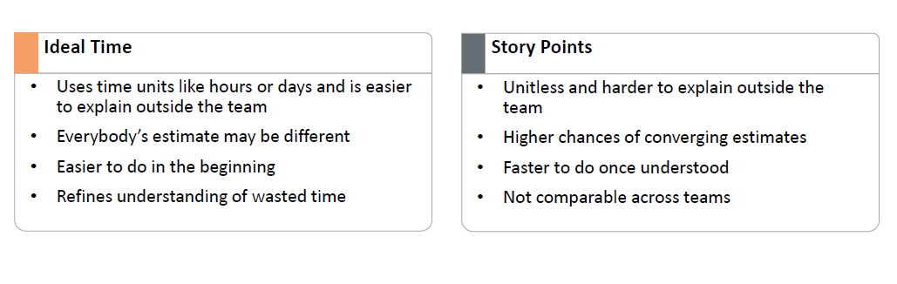
Agile Estimating, Planning, Monitoring, and Control
Ideal Time VS Story point

Slide 48
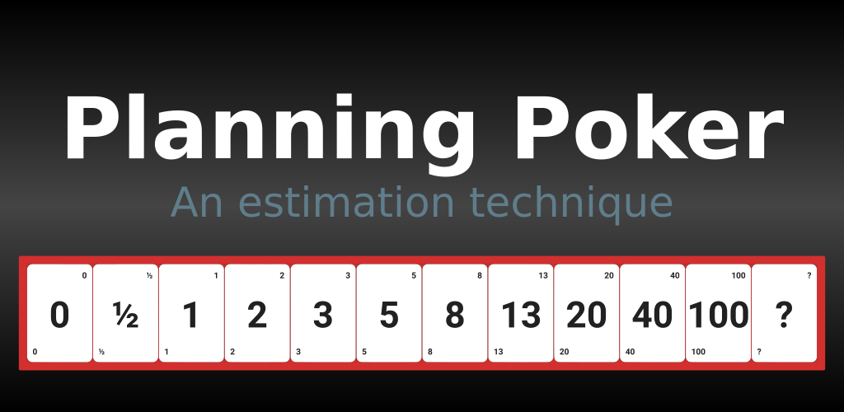
Agile Estimating, Planning, Monitoring, and Control
Technique of estimation is ?

Slide 49
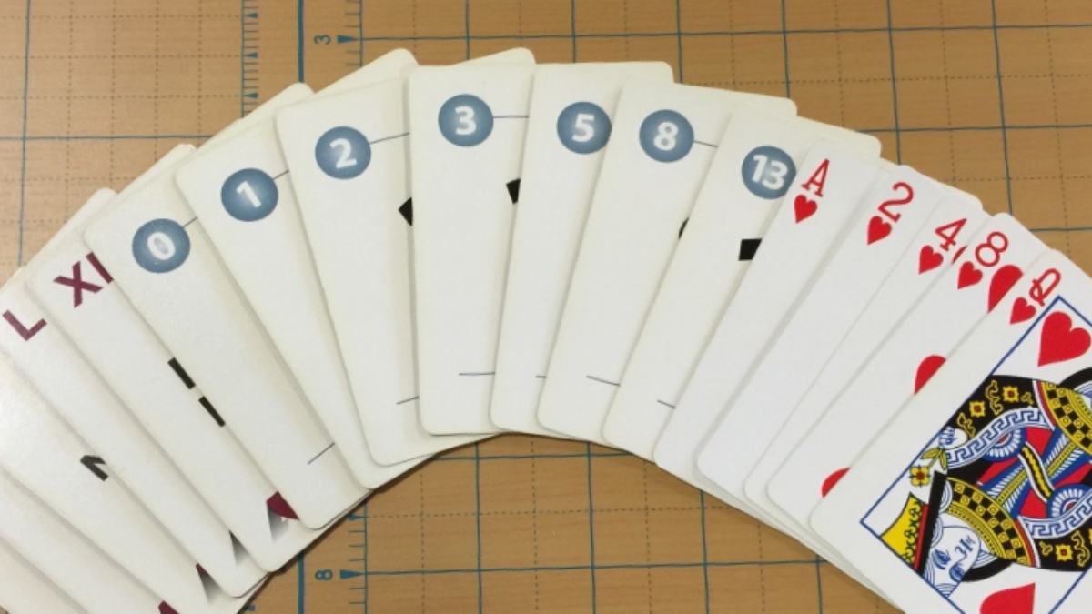
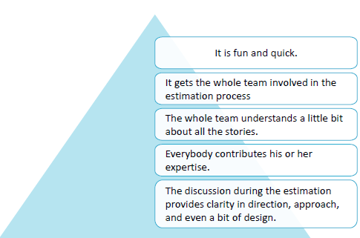
Agile Estimating, Planning, Monitoring, and Control
Advantages of Planning Poker

Slide 50
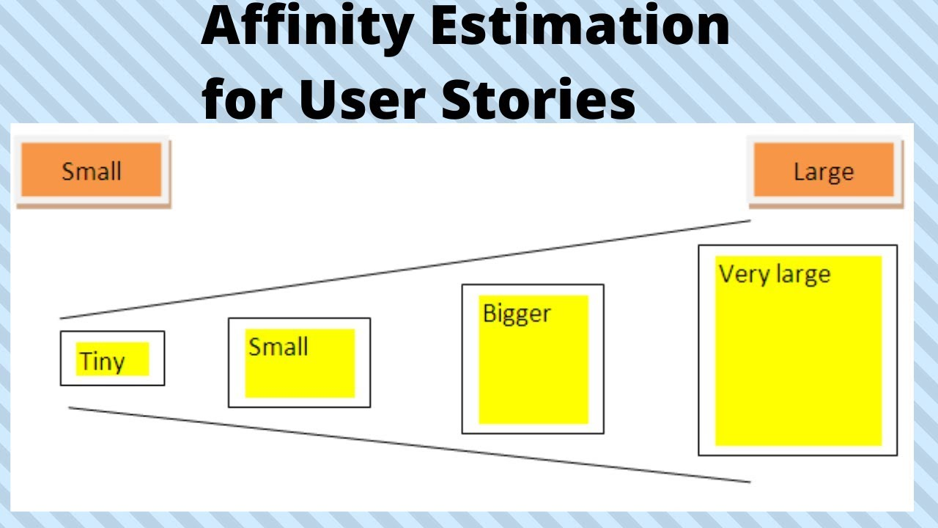
Agile Estimating, Planning, Monitoring, and Control
Useful when you want quick, reliable estimates for a large number of stories at a time

Slide 51
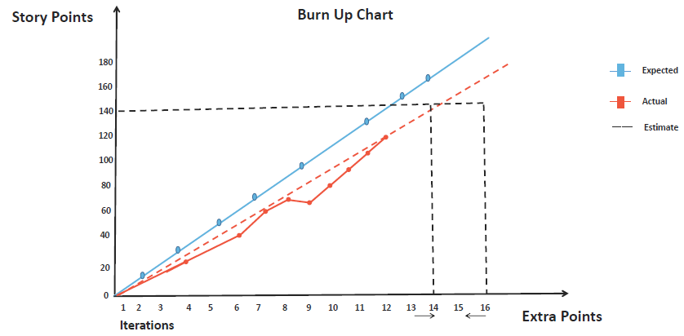
Agile Estimating, Planning, Monitoring, and Control
Control of the project
Use Burn Down Charts and other indicators to track projects and stay in control.

Slide 52


Slide 53

Agile Project Management Tools

Slide 54
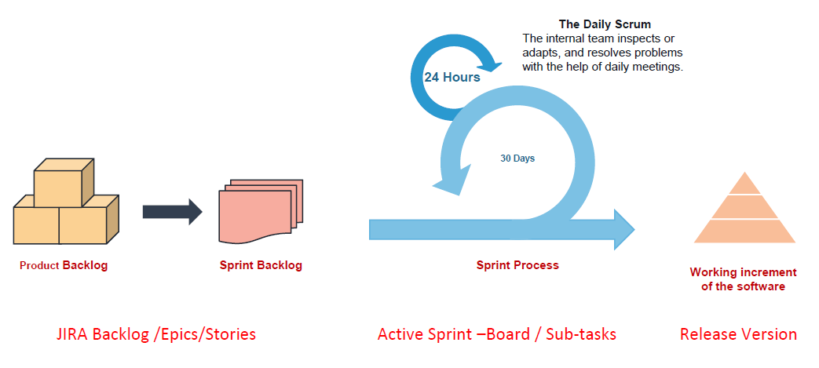
Scrum Ceremonies and JIRA Workflow

Slide 55
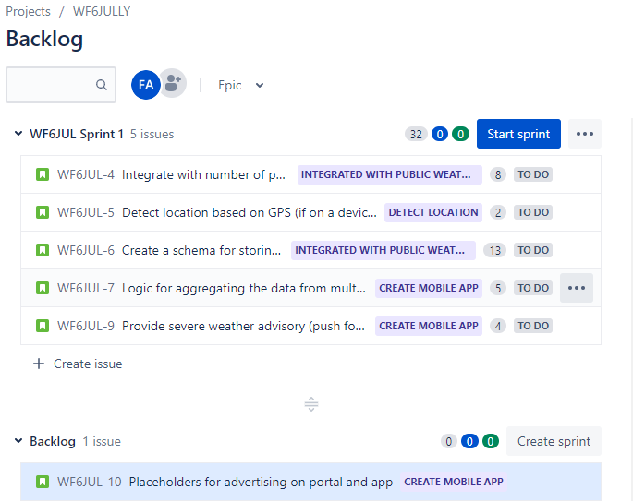
Scrum Ceremonies and JIRA Workflow
Example :

Slide 56
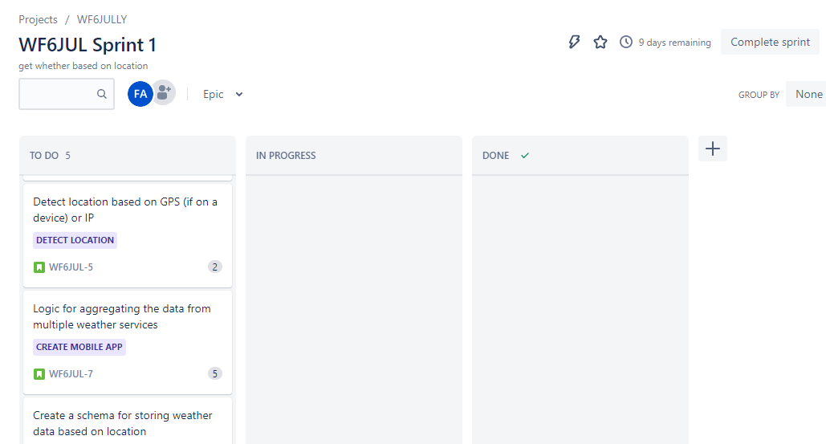
Scrum Ceremonies and JIRA Workflow

Slide 57
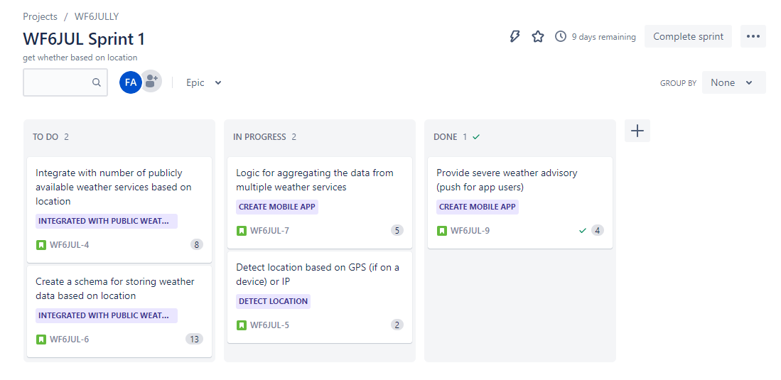
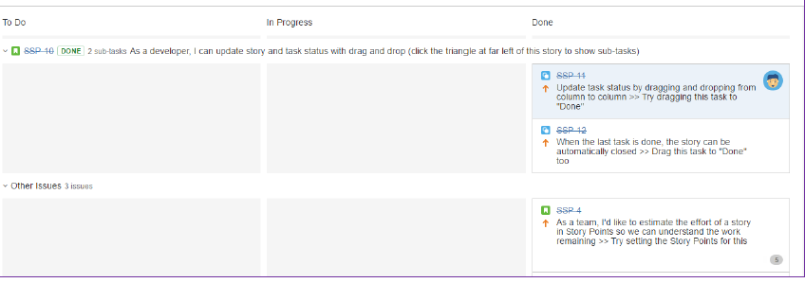
Scrum Ceremonies and JIRA Workflow

Slide 58
How I use it in my daily work :
1- when I facing any issue for daily case in my Technical work , I’m daily check with employee to reach a solution .
2- Any delay case with any employee , I calling him/her to understand what the issue and what the reasons for it , try to monitoring it in daily meeting if it need usually it solve with daily monitoring .
3- I always strive to cooperate with my team to provide the best results and appear as always cooperative team .
4- using JIRA to plan any user story and Backlog for the sprint of projects (as below in previous screenshot ).
5- customer satisfaction ☺ , I Try to solve the problem as soon as possible within the SLA for any issue .

Slide 59

Done By :
Fatima Attoun
Digital CRM Integration Analyst

